Slide 1

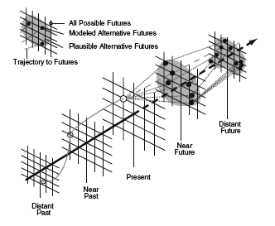

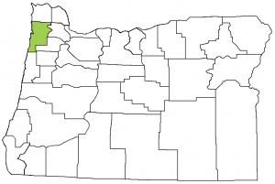
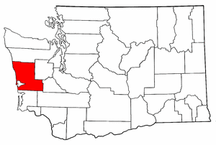
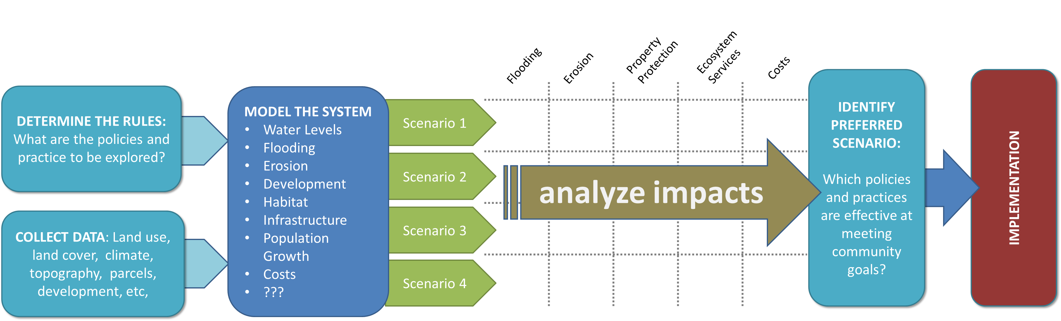
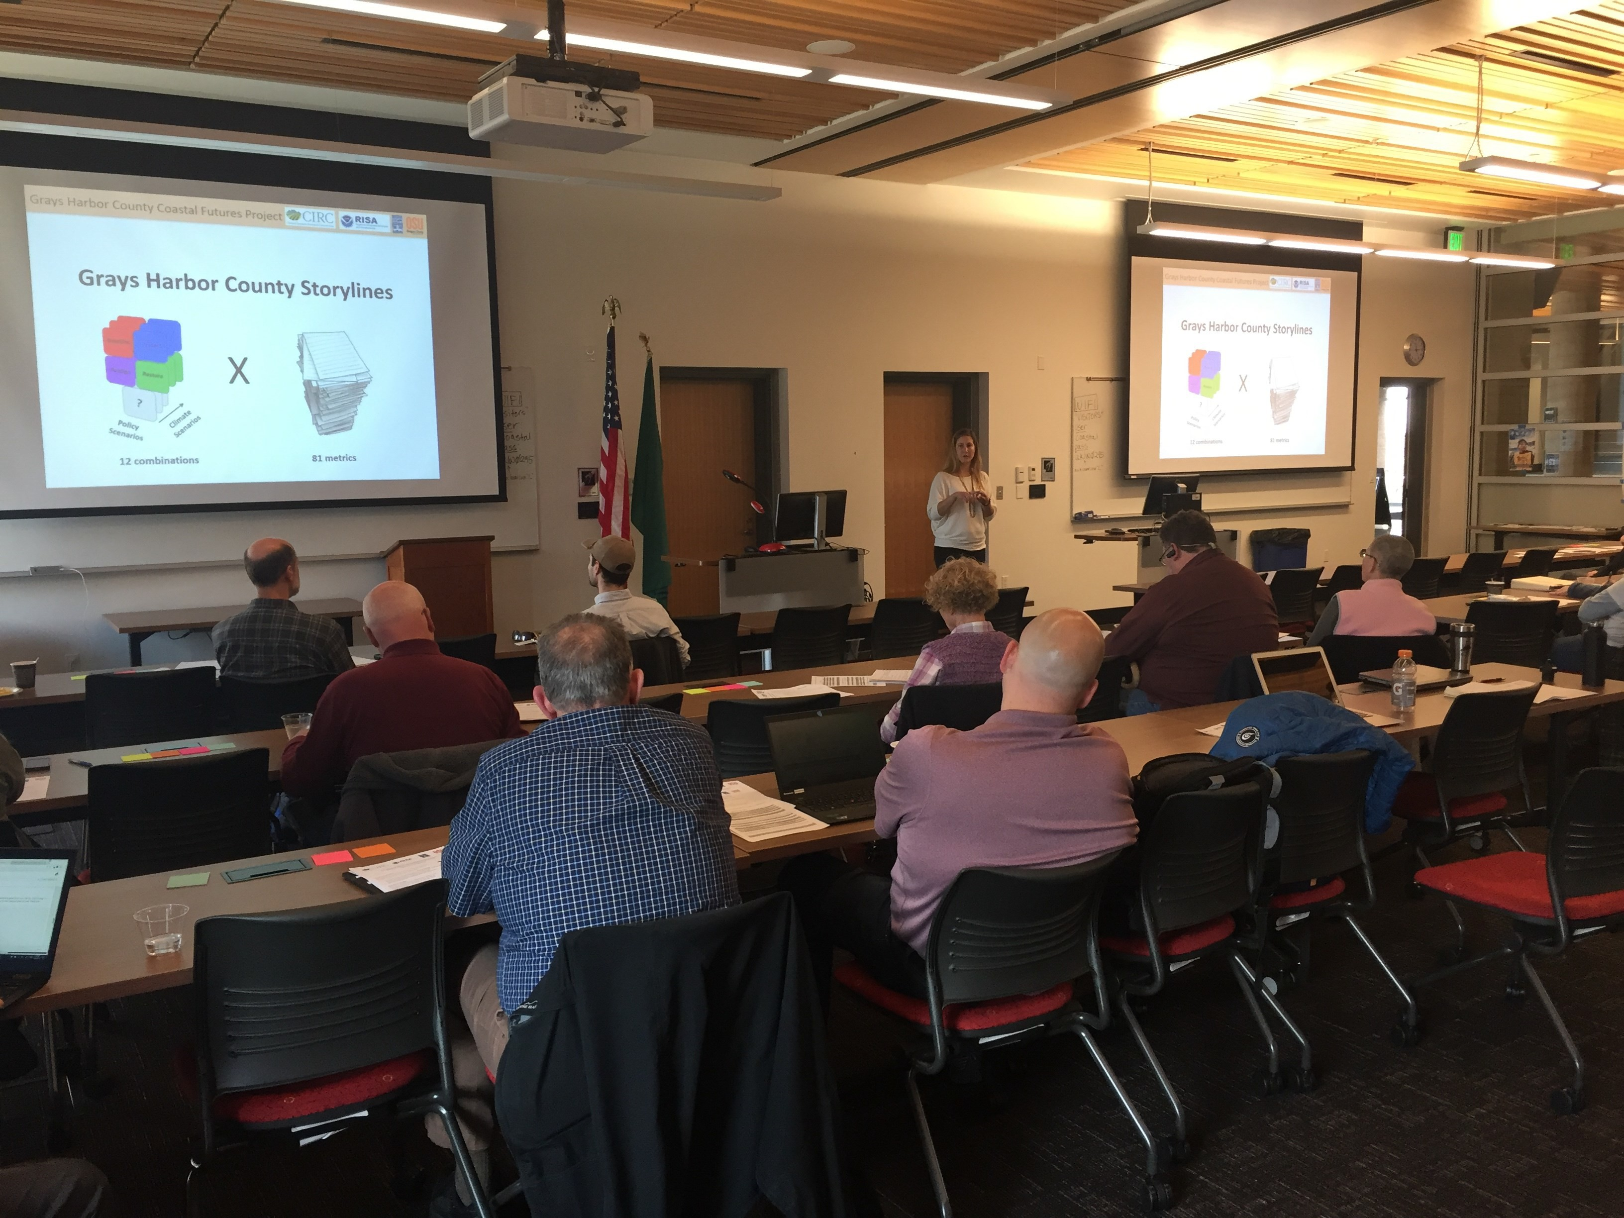
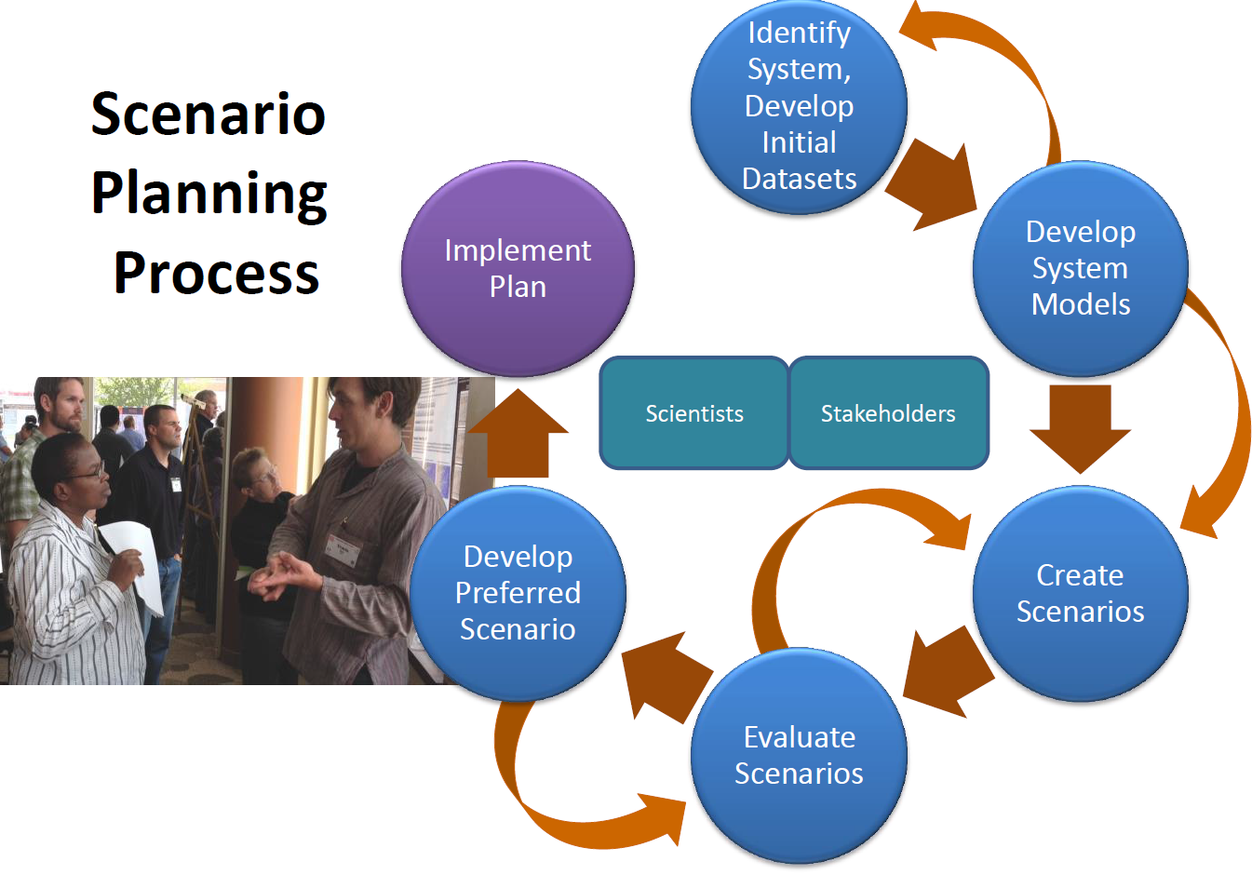
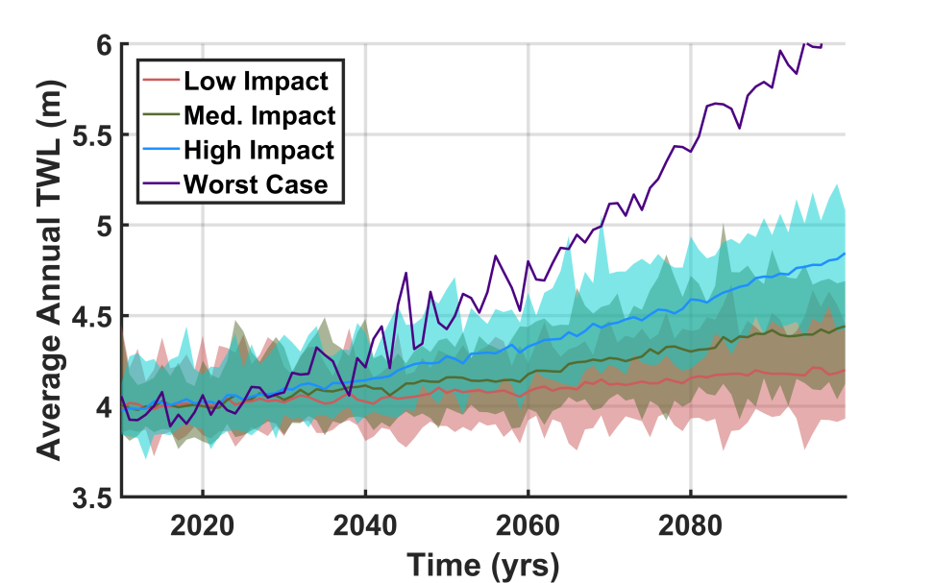
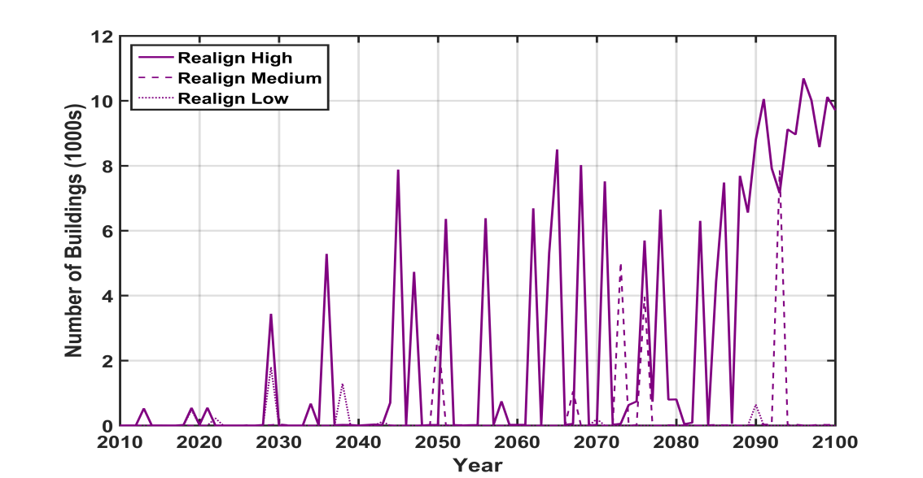
ENVISIONING A RESILIENT OREGON COAST
Co-developing alternative futures for adaptation planning and decision-making
ALTERNATIVE SCENARIOS FOR EXPLORING COMMUNITY FUTURES
John Bolte,
john.bolte@oregonstate.edu
Peter Ruggiero
Peter.Ruggiero@oregonstate.edu
MOTIVATION
FEATURED PROJECTS AND RESULTS
Create, explore and evaluate
trajectories of change via
Scenario Analysis
Tillamook County
Coastal Futures
Grays Harbor County
Coastal Futures
STAKEHOLDER ENGAGEMENT IS KEY!
Identify relevant endpoints
Develop strategies and policies to explore
Assess modeling results
Develop Preferred scenario
Stakeholder-driven Scenario Development
Cumulative cost of constructing new BPS in Protect (county-wide), versus constructing new DRP in Restore under low and high climate scenarios.
BPS constructed in a high impact climate scenario under Protect policy scenario in Ocean Shores.
2010
2030 2060 2090
Explore climate, population growth impacts on land use, property, infrastructure, and ecosystem services
Example Endpoints
Projected impacts of climate change on shoreline water levels in Tillamook, Oregon
Example of temporal change in backshore protection structures (BPS) in the Rockaway Beach littoral cell in Tillamook County, OR, from 2010 to 2100 under the status quo scenario with medium sea level rise scenario.
Number of Buildings in Gray’s Harbor County Impacted by Event Erosion in the High Impact Climate Scenario
Buildings within FEMA 100-year flood hazard zone
QUESTIONS & FEEDBACK
Current population density (2010) (left) and projected population density in 2100 (right) in Westport, WA
What types of model output, endpoint, or quantified resilience metric would most benefit your work?
What adaptation policies or rules would you most like to see incorporated into the model framework?
In this project we plan on adding more econometrics, concepts of equity and distributional consequences, and feedbacks with acute hazards. What else would you like to see us tackle?
Buildings removed from hazard zone under Realign scenario
2010 2100
Costs to build, maintain beach protective structures (BPS) under two management scenarios

