Slide 1
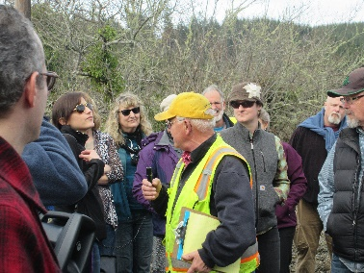
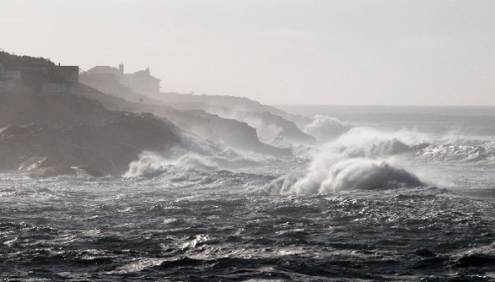
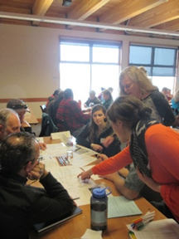
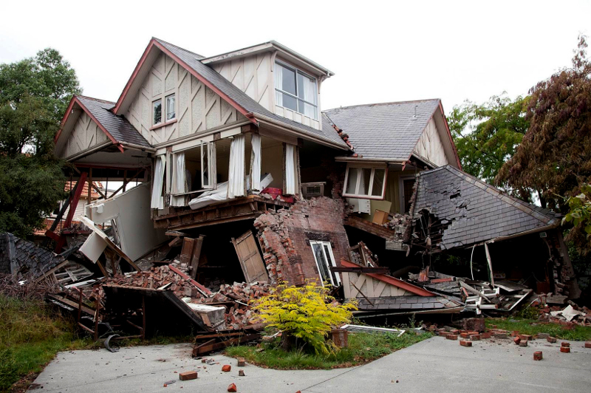
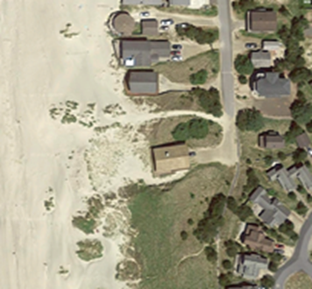
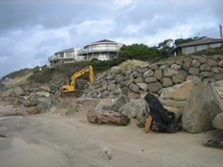
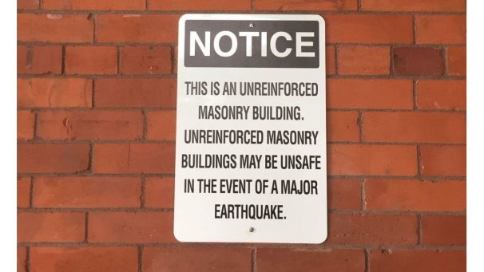
Jenna Tilt
tiltj@oregonstate.edu
ENVISIONING AN EQUITABLE & RESILIENT OREGON COAST
Katherine Stanton
stantoka@oregonstate.edu
POLICY ACTIONS
ENVISION
QUESTIONS
“Equitable resilience….. takes into account issues of social vulnerability and differential access to power, knowledge, and resources; it requires starting from people’s own perception of their position within their human-environmental system”¹
How does implementation of policy actions alter community resilience?
Incentivizing Retrofits²
Tax Credits: Tax credit similar to energy tax credits
Subsidies: Needs-based grants to offer free or reduced retrofits to low-income homeowners
Apply different rates of retrofitting:
Housing Characteristics
Household Demographics
Equitable Resilience Considerations
Who in the community is most impacted by these policies, and where?
Who is left out, and where?
What are the community cost and benefits of these policies?
Over what period of time is the adoption of these policy actions most effective?
Is understanding how the impacts of policy actions are distributed across communities something that interests you?
If so, what types of model output, endpoints, or quantified resilience metrics would most benefit your work?
What coastal adaptation/resilience policies should we focus on to show these impacts?
Outside of the Envision model, what qualitative information is important to you in order to understand community perceptions and responses to coastal adaptation/resilience policies?
Do you know of other data sets or models we should be aware of?
Who else should we be talking to?
What else should we be doing to ensure that this work results in actionable knowledge?
¹ Matin, N., Forrester, J. and Ensor, J. (2018). What is equitable resilience? World Development, 109, 197-205.
² OSSPAC (2018). Encouraging homeowner resilience through earthquake insurance and seismic retrofit. Pub# 18-01, The State of Oregon.
Notes:
Mitigation Action Items
Flood: Building a network of green infrastructure facilities can decrease flooding on properties behind seawall
Erosion Control (Steve):
Land Use Planning: Identify and evaluate at risk areas that may benefit from green infrastructure practices and hazard overlay zoning.
Community Engagement and Outreach: Engaging the public in planning and designing green infrastructure projects may improve natural hazard awareness

