Slide 1
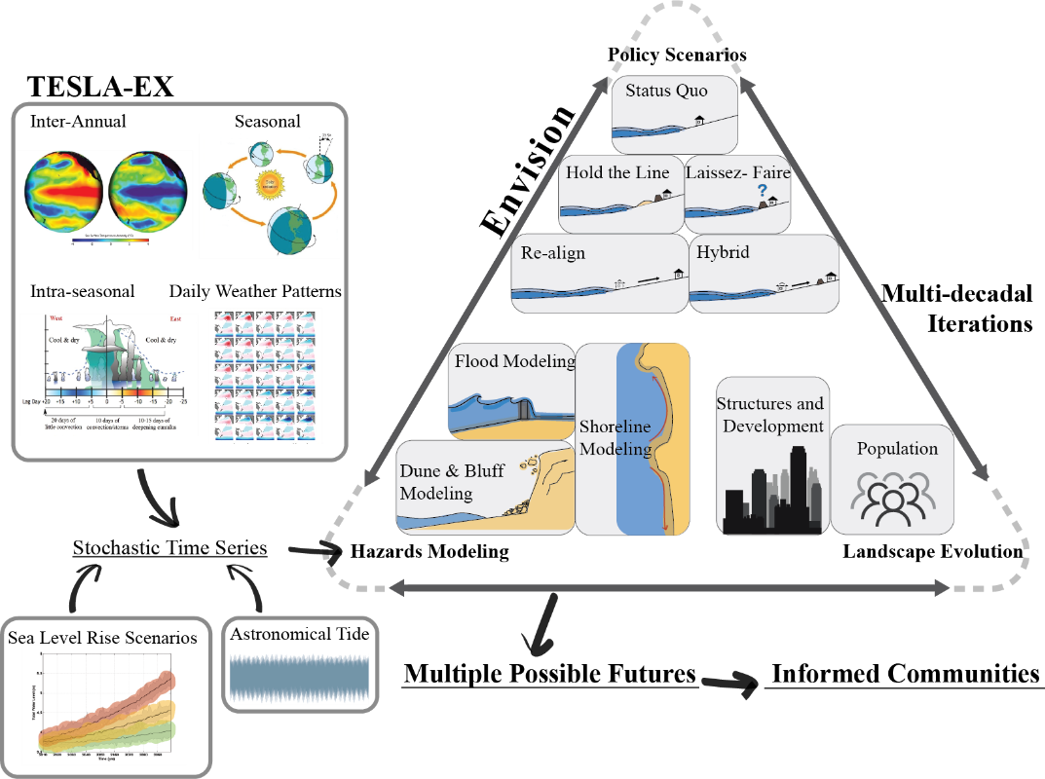
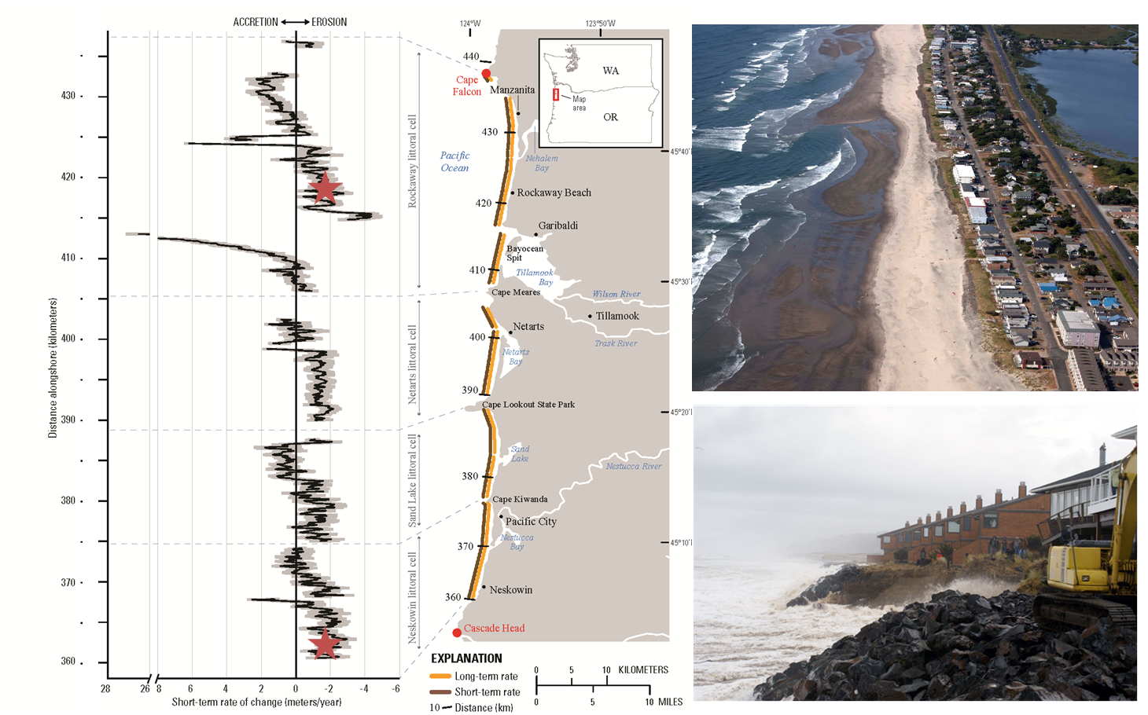
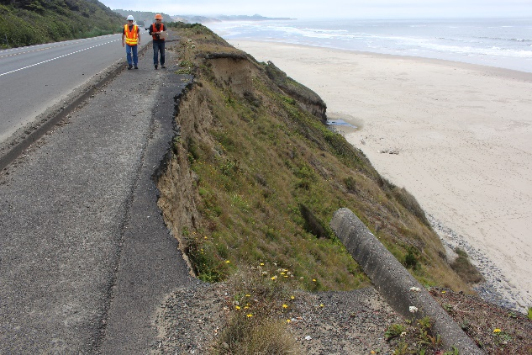
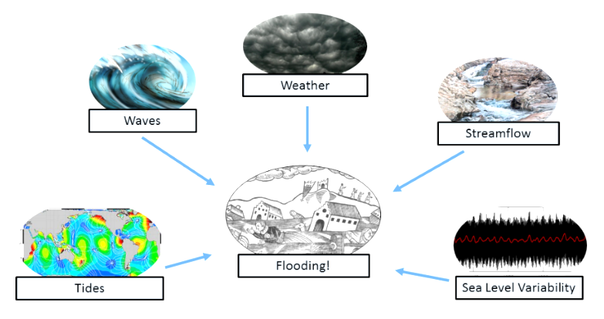
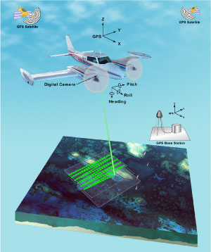
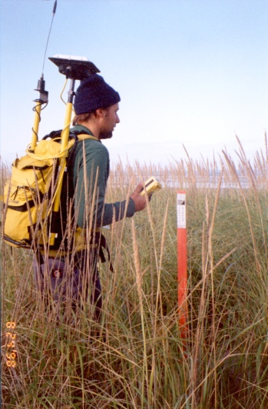
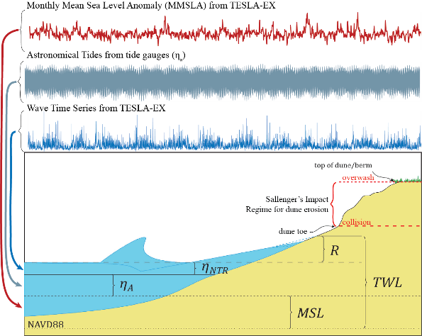
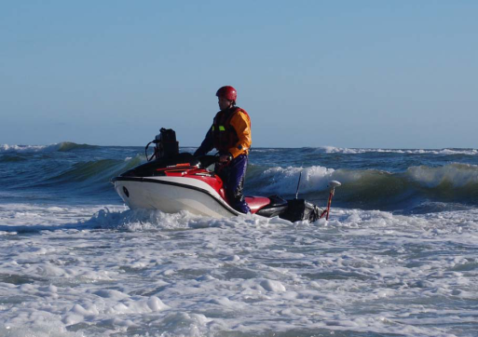
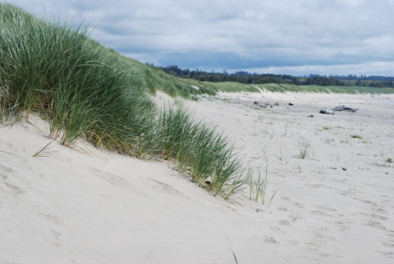
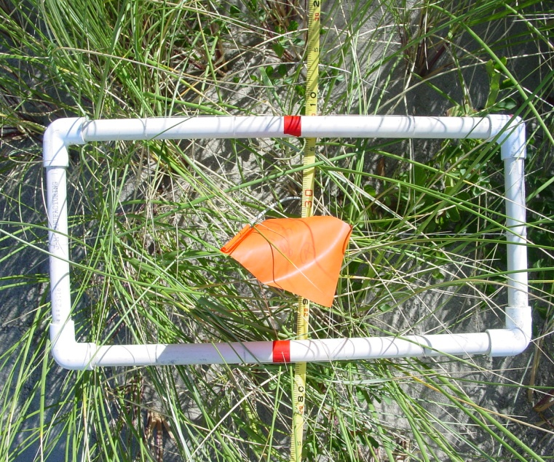
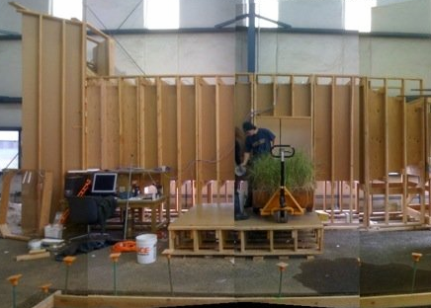
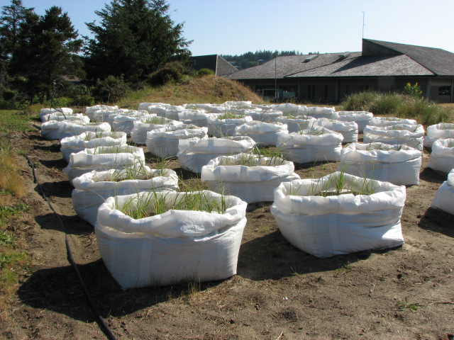
ENVISIONING A RESILIENT OREGON COAST
Co-developing alternative futures for adaptation planning and decision-making
CHRONIC COASTAL HAZARDS
Peter Ruggiero
Peter.Ruggiero@oregonstate.edu
Meredith Leung
leungmer@oregonstate.edu
MOTIVATION
FEATURED PROJECTS AND RESULTS
Hazard Mitigation Objectives for Chronic Coastal Hazards
Protect Infrastructure
Plan for reducing impacts
Protect and restore ecosystems
Hazards and Impacts
Capturing Impacts of Climate Change in Chronic Hazards Models
Initial Application
Research that Supports this Effort:
Shoreline Change Analyses and Projections
Extreme Water Level Modeling
Nearshore/Beach/Dune Monitoring and Modeling
Sediment transport patterns in Oregon shift based on storm events, seasons, and multi-decadal climate oscillations¹.
What policies should we enact today if current erosional and depositional patterns will change in 10 years? In 50?
1. Coastal Erosion 2. Coastal Flooding
Many complex processes interact to drive extreme water levels^{2,3}.
What timescales of predicted
water levels are most useful
for management decisions?
Time series of waves are used to drive shoreline change flooding and erosion sub-models in Envision. A new model framework (TESLA-EX) allows us to derive probabilistic wave time series that incorporate sea level rise, climate oscillations, seasons, etc. into our chronic coastal hazards models.
Sea level rise and changes to storminess patterns may significantly increase the frequency of coastal flooding and erosion.
Impacts include :
Loss of life
Damage to infrastructure and ecosystems
Disrupted networks
Significant loss of revenue
Policy questions/headaches
Adaptation options include:
Monitoring
Risk assessments
Changes to land use planning such as implementing coastal hazard zones, conservation easements, construct only in safest sites, etc.
Event to Seasonal to Inter-annual coastal change observations for understanding impacts to life, property, and ecosystems^{4,5}.
Are you familiar with additional models or datasets that should be included in this study?
TESLA-EX produced time series can be used to predict dune erosion using lidar derived topography and computational erosion models.
QUESTIONS & FEEDBACK
REFERENCES
How do chronic coastal hazards impact your work?
How could your work benefit from projected probabilistic chronic hazards? What questions might they answer?
Anderson, D., et al. (2018) doi: 10.1029/2018JF004689
Serafin, K., Ruggiero, P. (2014) doi:10.1002/2014JC010093
https://tidesandcurrents.noaa.gov/
http://nvs.nanoos.org/
Hacker, S. D., et al. (2012) doi: 10.1111/j.1600-0706.2011.18887

