Slide 1
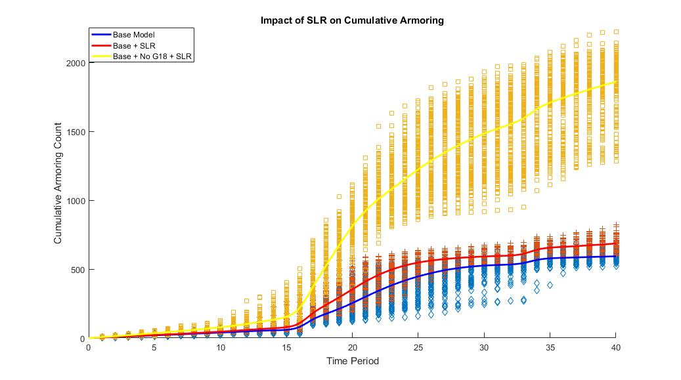
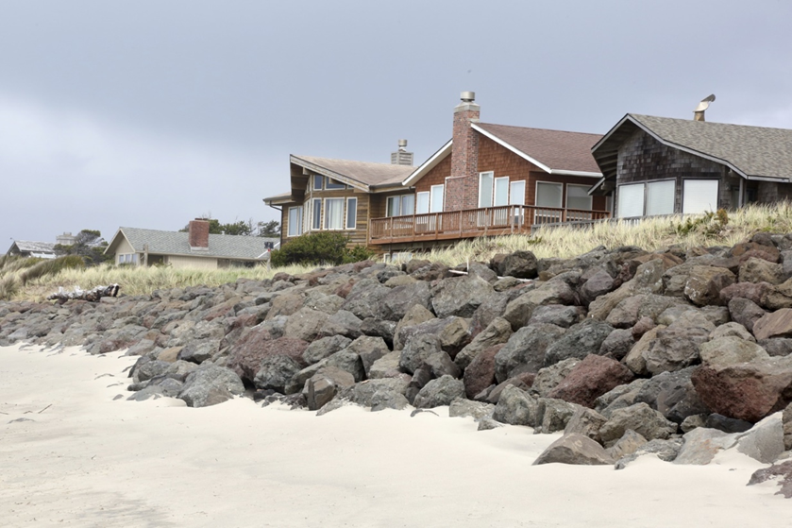
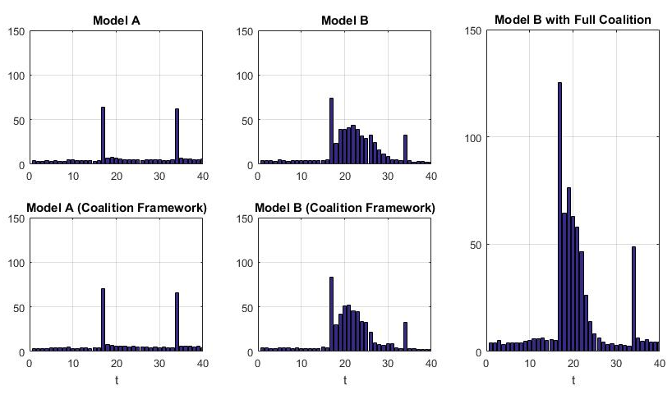
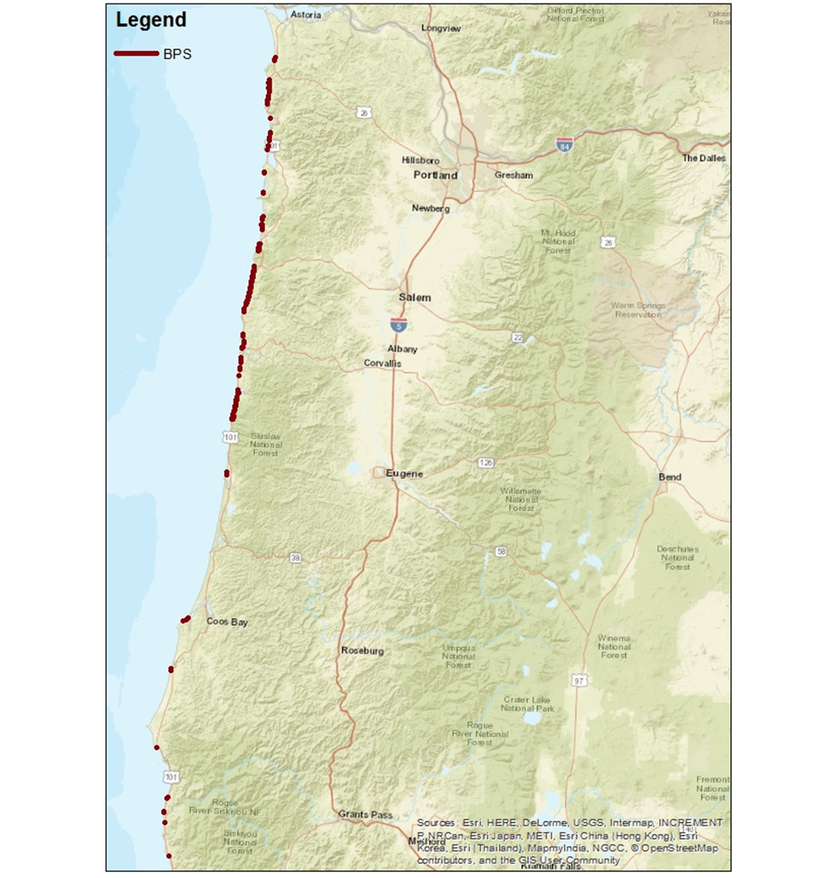
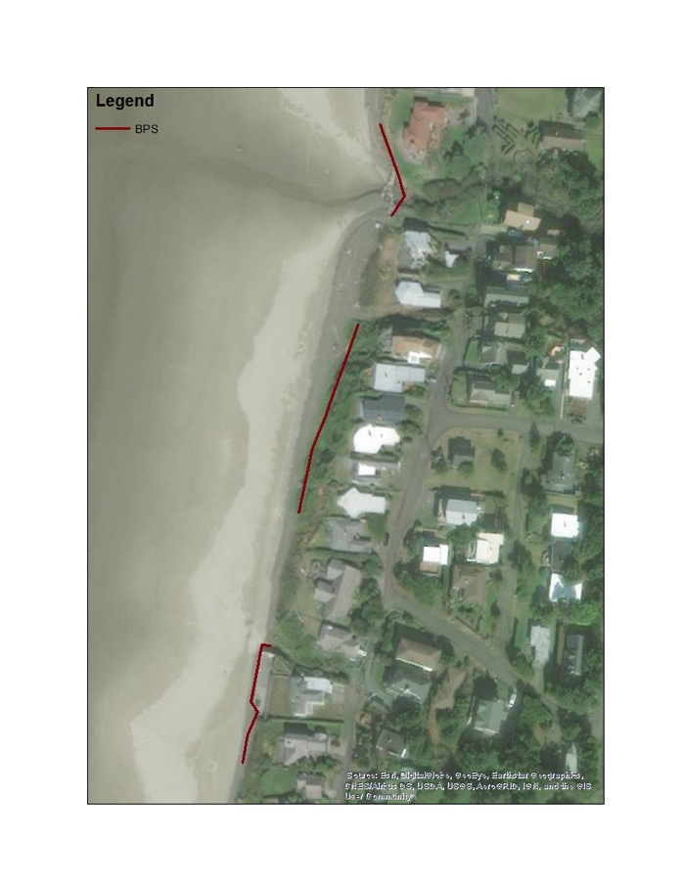
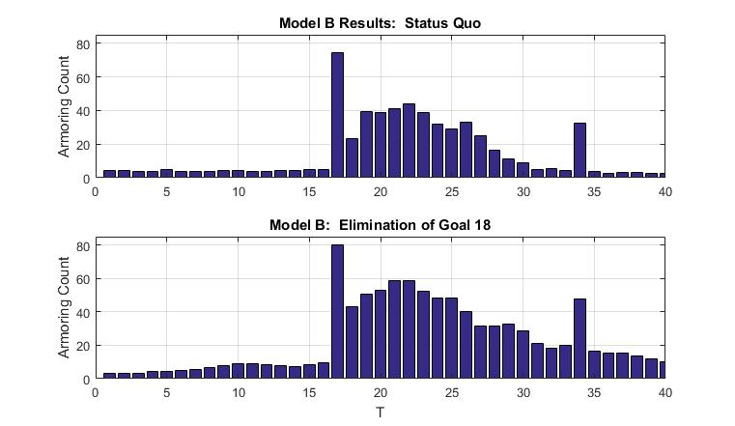
HOLD THE LINE!
College of Agricultural Sciences – Applied Economics Department
Modeling private coastal adaptation through shoreline armoring.
W. Jason Beasley¹ & Steven J. Dundas²
THE HOW
THEORY
Real Option Theoretical Framework:
$${NV}_{it}=ENPV\left(R_{it}=0\right)+{OPV}_{it}+L_{t}\left(N_{it}\right)−ENPV\left(R_{it}=1\right)<0$$
Suggests that a household will wait to armor until the benefits from armoring exceed the costs of armoring. Waiting to install provides value to the homeowner.
We hypothesize that land characteristics which convey risk, neighboring actions (peer effects) and strategic actions (group install) are key determinants.
DATA
Land Characteristics: Using GIS processes, varying LIDAR datasets, state permit databases, and tax records we compile measures from 1990-2014 for Tillamook & Lincoln County. These measures include, but are not limited to, mean parcel elevation, distance from the structure to the shoreline, and short-term erosion rates.
Neighboring Actions (Peer Effects): In each period we calculate the number of armored direct neighbors (generally between 0-2), and the number of armored neighbors within 2km (but not directly related). These measures vary over time and capture community activity levels.
Storms & Time: El Niño–Southern Oscillation (ENSO) effects (occurring approximately every 17 years) and a time-trend are used as controls.
Strategic Action (Coalition): Assumptions on unobserved coalition rejection are made to allow an alternative specification which controls for the effect of coalition (cost-sharing) on the decision process.
EMPIRICAL SPECIFICATION
Likely problems with repeated decisions from panel data and unobservable measures correlated with controls.
Final empirical specification utilizes a Correlated Random Effects (CRE) Probit estimation:
$$\operatorname{Pr}\left(NV_{it}≤0 (Install_{it=1) }) | {X′}_{it},{N′}_{it},{Z′}_{t},{{\overline{X}}_{i},{\overline{N}}_{i}μ}_{i}\right)= Φ({X^{′}}_{it}β+{N^{′}}_{it}α+{Z^{′}}_{t}+\left({\overline{X^{′}}}_{i}γ+{\overline{N^{′}}}_{i}θ+τ_{i}\right))$$
X: Land Characteristics, N: Neighbors, Z: Storms & Time
SIMULATIONS
Monte Carlo simulations are used to understand emergent temporal and spatial patterns of armoring installation over the next 40 years.
Simulations are used to understand the implications of:
Oregon legislation (Goal18) on armoring restrictions.
Climate change induced sea-level rise on armoring patterns and volumes
The interaction between policy and climate change
Policy implications
Private armoring decisions are made at the parcel level and may result in spatial spillovers leading to higher volumes of localized armoring.
Public beach nourishment has been shown to theoretically lead to under provision of protection due to free-ridership.
An optimal strategy of coastal protection must be designed to limit private parcel adaptation, while providing optimal public nourishment in appropriate communities.
Within the private decision process, failing to account for peer effects will lead to dramatically different expected armoring patterns. Peer effect outcomes are larger and highly different spatially due to clustering patterns of installation.
Within the private decision process, failing to account for the coalition effect leads to different temporal patterns of installation.
Beaches that have faced erosion for decades may be likely to continue to do so. While our findings suggest that Goal 18 will preserve 10.5% of the coastline in Tillamook & Lincoln county, an anthropocentric perspective would find 10.5% of coastal parcels facing irreversible loss. Pressure to update Goal 18 to allow more private adaptation is likely given the enormity of potential damage over the next four decades.
The graph above demonstrates the impact of climate change induced sea-level rise. The mean armoring level after 40 years from our base model (593) increases to 1,860 without Goal 18 and with sea-level rise. This further illustrates the challenges that will be faced by coastal communities trying to balance the preservation of the natural coastline and the protection of private property.
Example of Armoring along the Oregon coast
The What
Shoreline armoring (i.e. riprap revetments, seawalls) are used to affix the beach at a given point to protect at risk properties from coastal erosion and storm surges.
Left - Land characteristics model (top) and “coalition game.” (bottom)
Middle – Base model with Peer Effects (top) and “coalition game.” (bottom)
Right – Assumptions on coalition effect within the “coalition game”
RESULTS
Empirical results support our initial hypotheses regarding risky characteristics of land, peer effects and cost-sharing through group installation. Our findings are robust to functional form specification.
We find that peer effects tend to dominate the model when included. Model A above is a pure land characteristics model. ENSO related spikes have no feedback effect. Model B includes the peer effects of neighbors and exhibits neighboring effects after an ENSO shock. This effect substantively increases overall armoring projections (from 309 to 585). Model B within the “coalition game” has little impact on increasing armoring levels from Model B without the game (593 to 585). However, the coalition framework pulls forward more at-risk parcels producing armoring events in earlier periods. Coalition effects further increase total armoring to 665 parcels.
Below, we find that Goal 18 would prevent 363 parcels from armoring over the next 40 years. This accounts for 10.5% of all coastal parcels in Lincoln & Tillamook County.
Armoring locations as of 2014. Inset: Example of spatial variation.
THE WHY
UNESCO estimates 90% of beaches worldwide are eroding. (Neumannn et al. (2015) suggest the majority of US coastal adaptation expenditure by 2100 will be in shoreline armoring. Despite this, the armoring process has received little attention in the literature. The primary alternative adaptation measure, beach nourishment, has been well studied. There are distinct differences between the two:
 | Armoring | Nourishment
Decision Maker | Individual homeowner | Community
Cost | Cheap relative to property value | Expensive
Upkeep | Minimal maintenance | Cyclical replenishment cycle
Theoretical Impact | Negative Externality (Over abundance) | Positive Externality (Under utilization)
This research attempts to fill the gap in the literature. An optimal coastline management strategy is likely to employ all adaptation measures.
Top – Peer effects model
Bottom – Peer effects model if all Oregon parcels were eligible
1 – PhD Candidate, Applied Economics Department, Oregon State University, 319A Ballard Extension Hall, 2591 SW Campus Way, Corvallis, OR 97331, Email: beasleyw@oregonstate.edu
2 – Assistant Professor, Applied Economics Department, Oregon State University
Notes:
Pink boxes are place holders for photos. Must be in Slide Master mode to swap in photos.

